Slide 1
Learning Objectives
By the end of this lecture, you should be able to:
1. Understand common statistical model selection approaches, including AIC, model averaging, and stepwise regression, and recognise their limitations and potential pitfalls.
2. Understand the principles of causal model building, including directed acyclic graphs (DAGs), d-separation, and Structural Equation Modelling (SEM).
3. Appreciate the difference between predicting relationships and understanding causal relationships.
Please go to this link, everything you need to do is explained there, https://pad.riseup.net/p/ES3307_Tharaka-keep

Slide 2
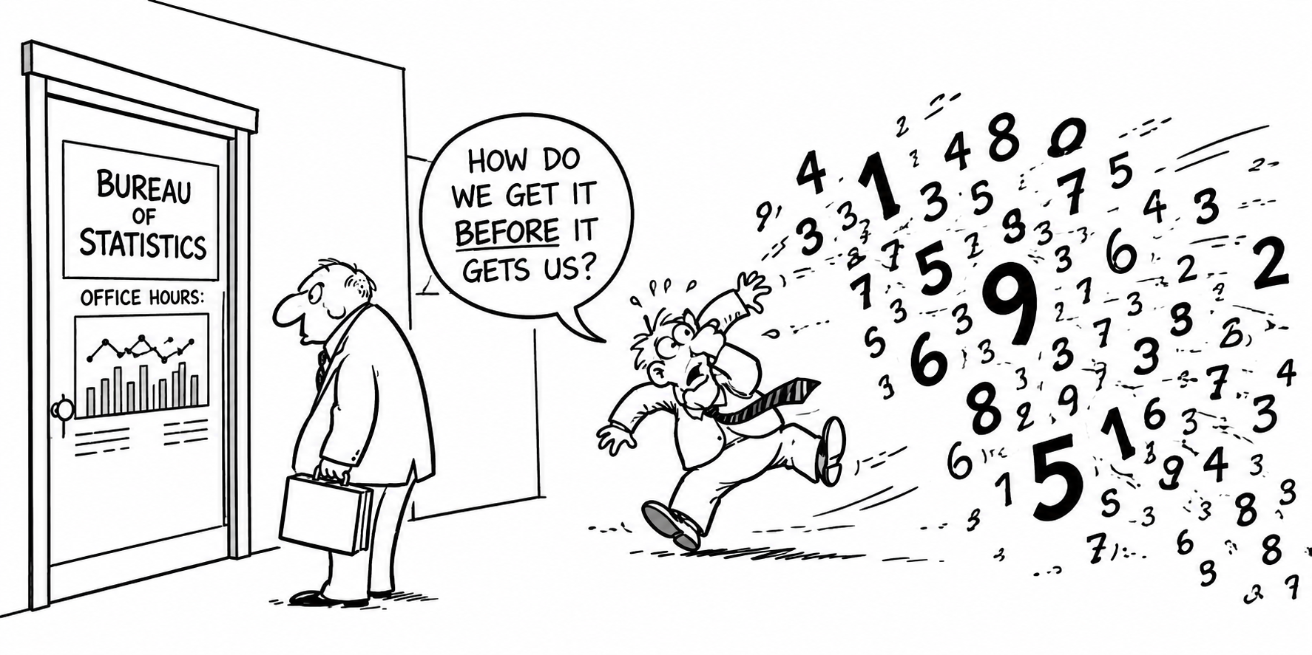
OK, Our data is in, Now what to do with it?

Slide 3
But Which Predictors? All? Some? Which?!?!?!?!
x₈
x₃
x₁
x₂
Y
x₇
x₄
x₅
x₆

Slide 4

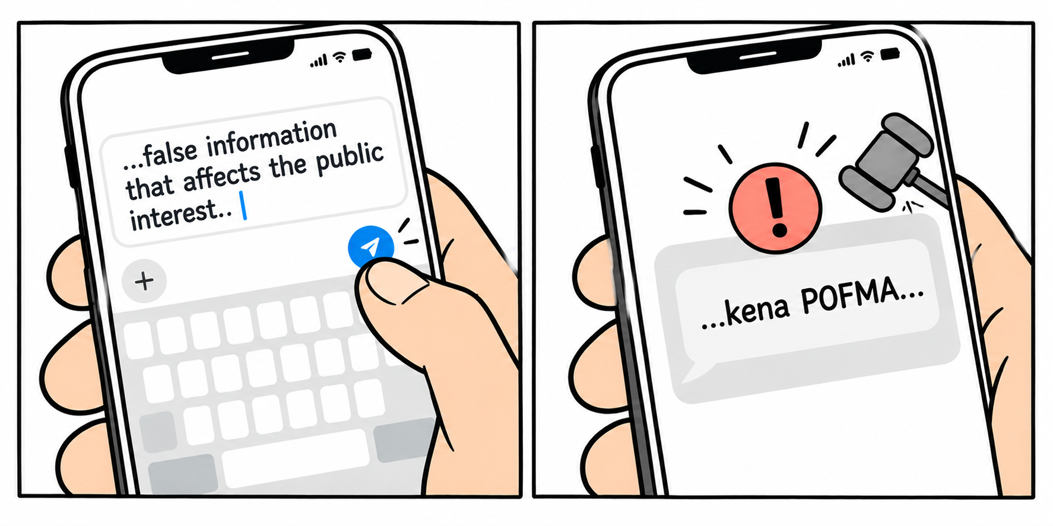
Information Theory
Information: Reduction in uncertainty caused by leaning an outcome (i.e., saying that when something is more uncertain than something else).
Information theory: A framework deriving rigorous metric for uncertainty (e.g., AIC = Akaike [An] Information Criteria).
Today
Tomorrow ?
Hirotugu Akaike

Slide 5
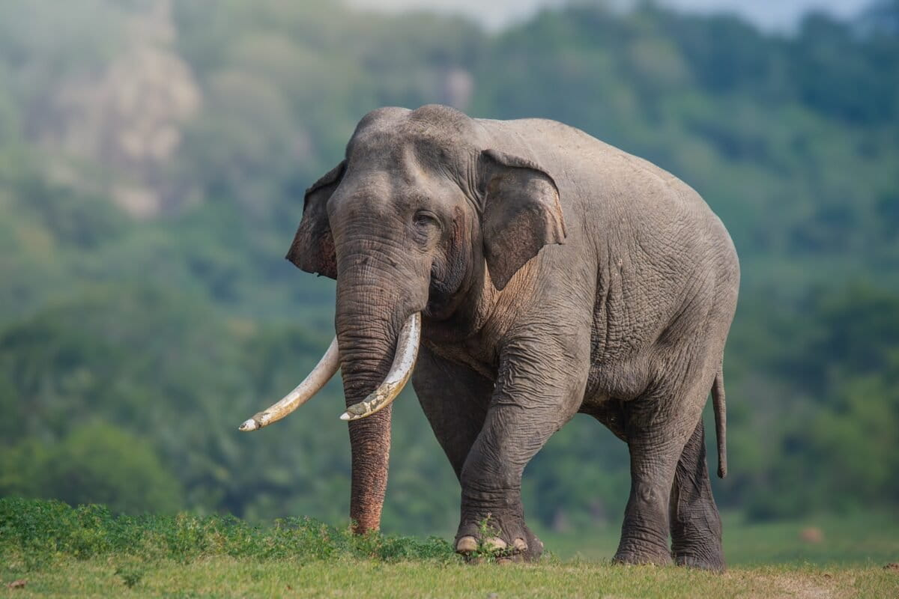
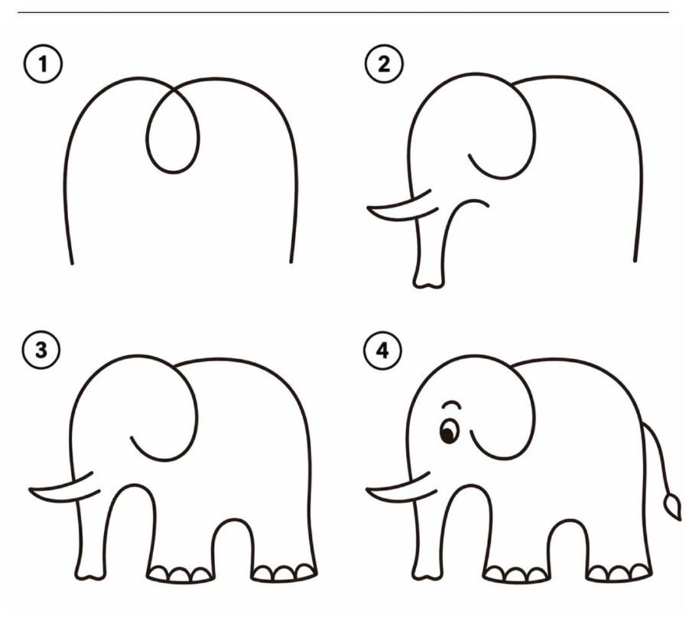

How many parameters does it take to fit an elephant?
Lower AIC means less information is lost by a model (i.e., most predictive model).
AIC = - 2 log (L(θhat | data)) + 2K
K = Number of Parameters
We want to balance the idea of perfect fit with generality.

Slide 6
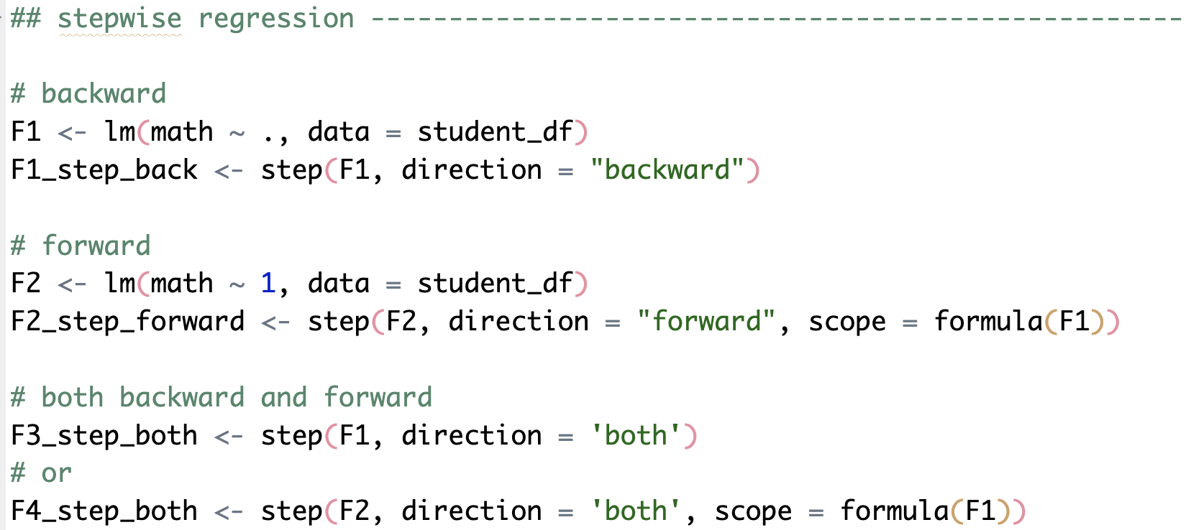
Model Mis-selection
Let’s open Script_1 and run following codes

Slide 7
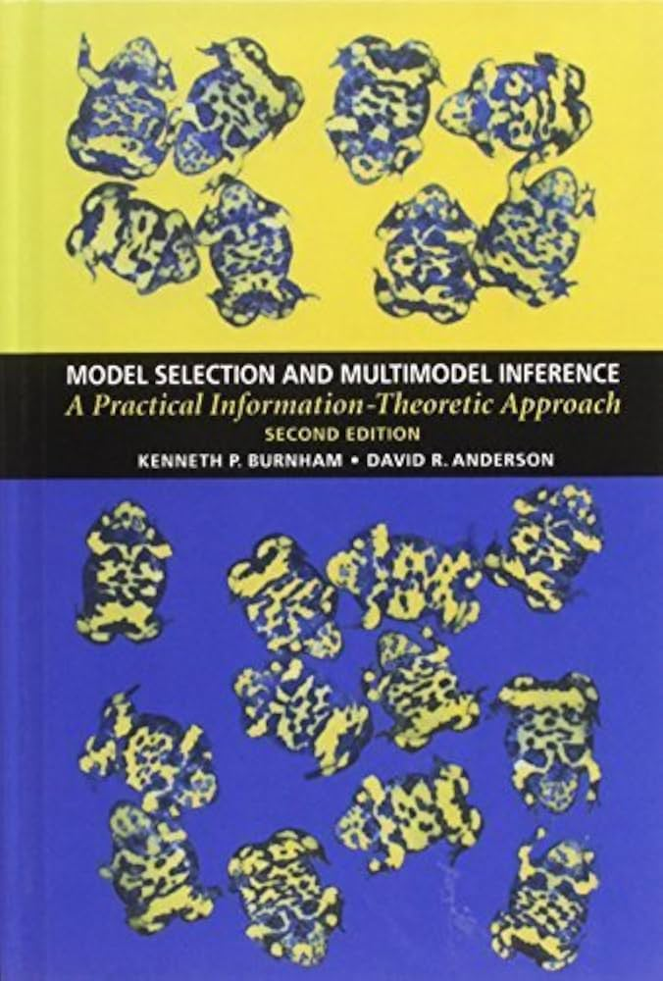
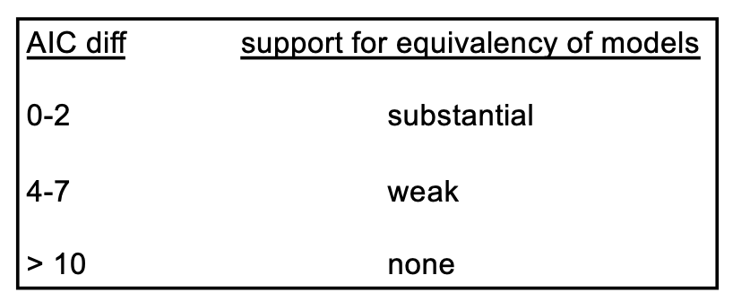
Model Mis-selection
Model averaging
Burnham, K.P. and Anderson, D.R. 2002. Model Selection and Multimodel Inference. Springer Verlag. (second edition), p 70.

Slide 8
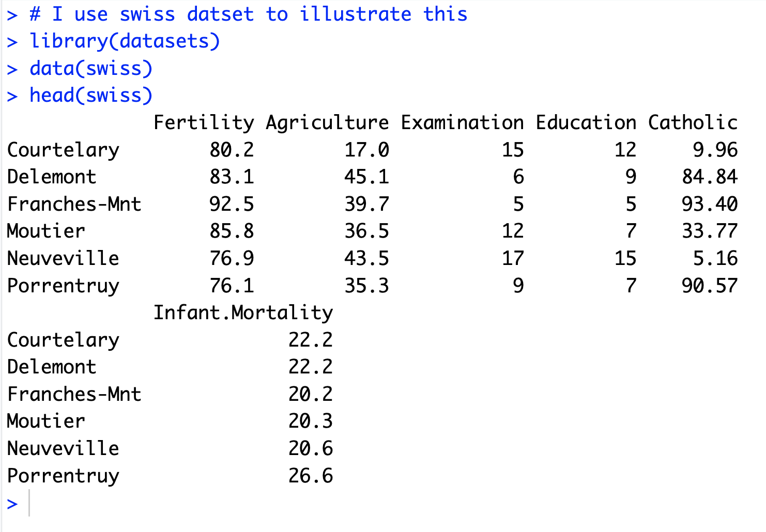
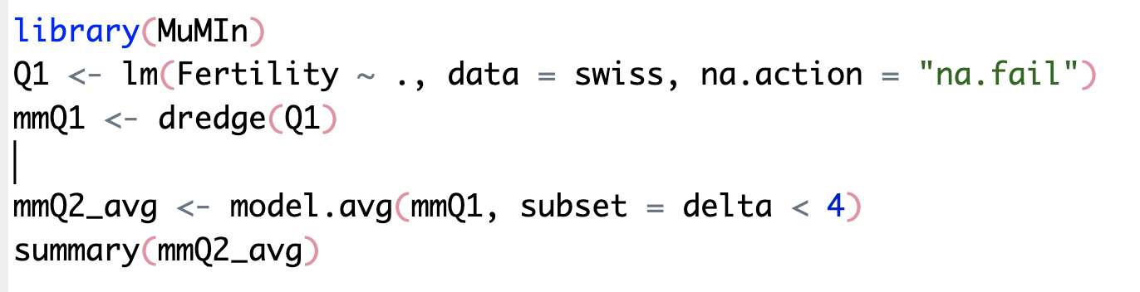
Model Averaging
Let’s open Script_1 and run following codes
For more details about the dataset, https://stat.ethz.ch/R-manual/R-devel/library/datasets/html/swiss.html

Slide 9


Slide 10
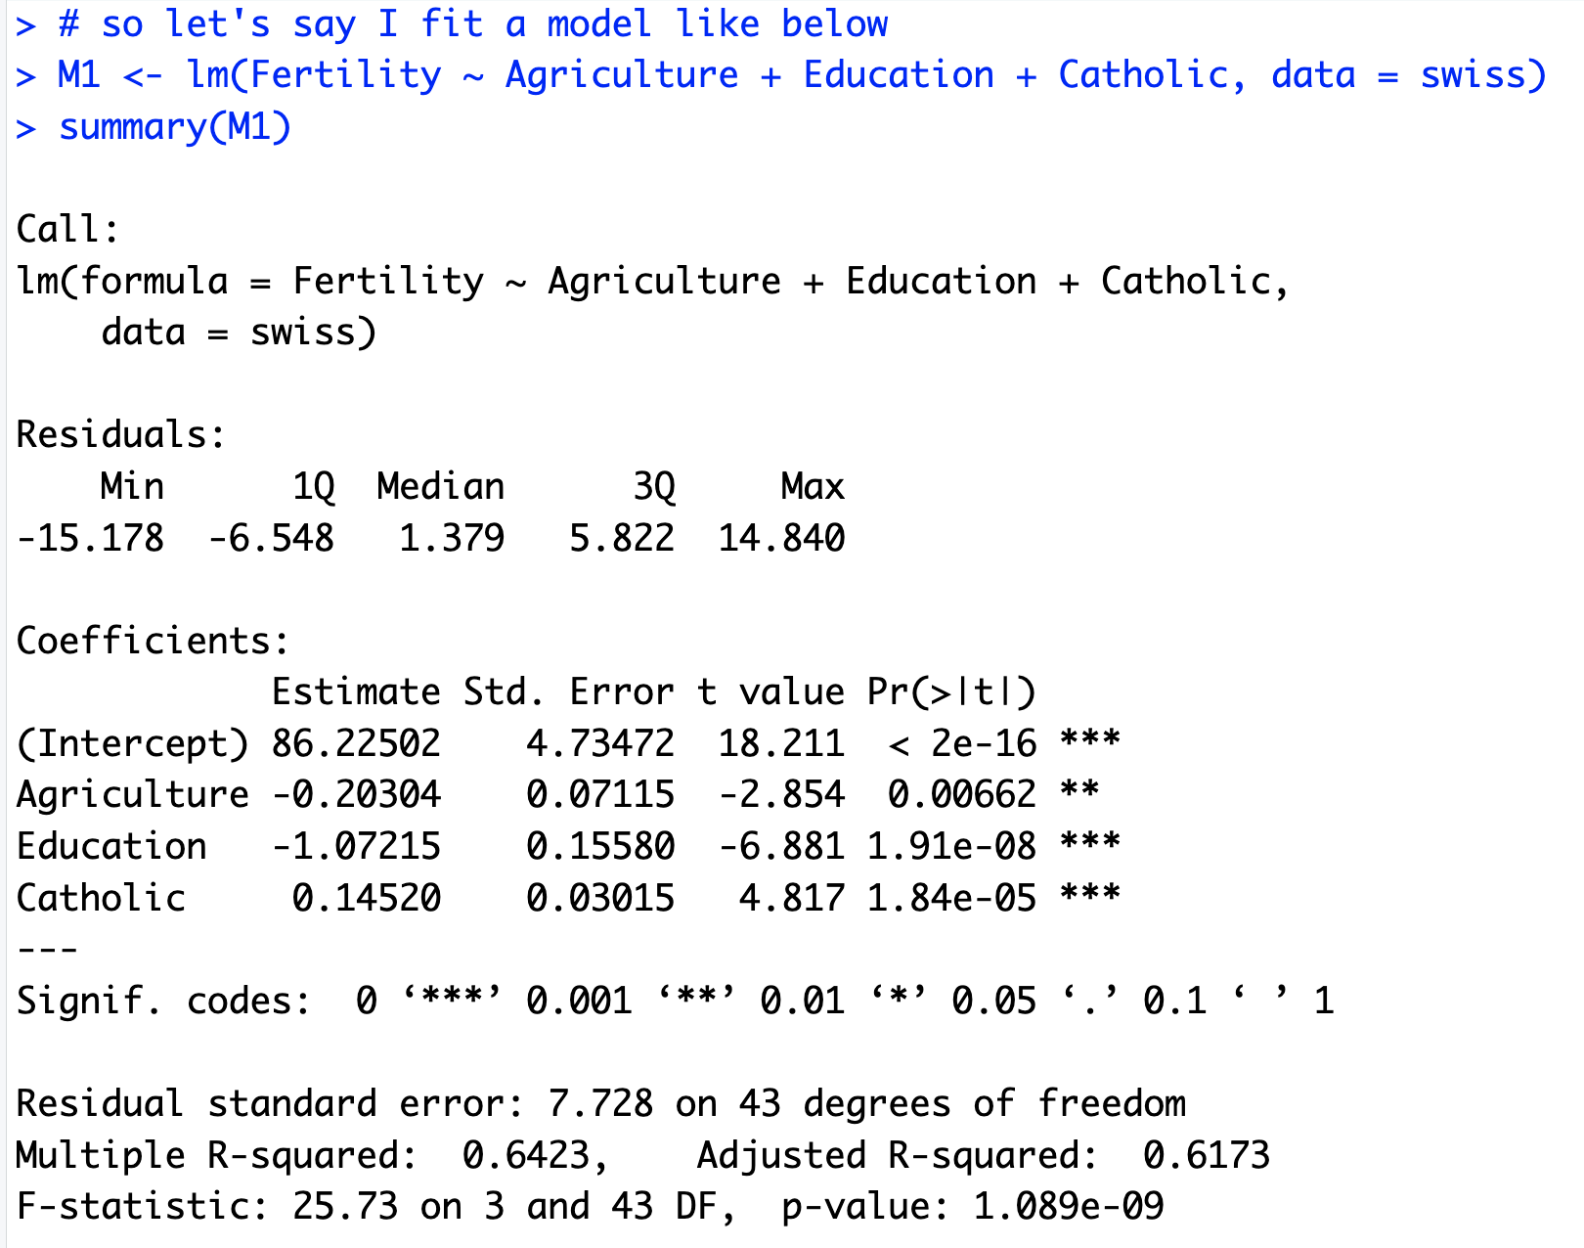
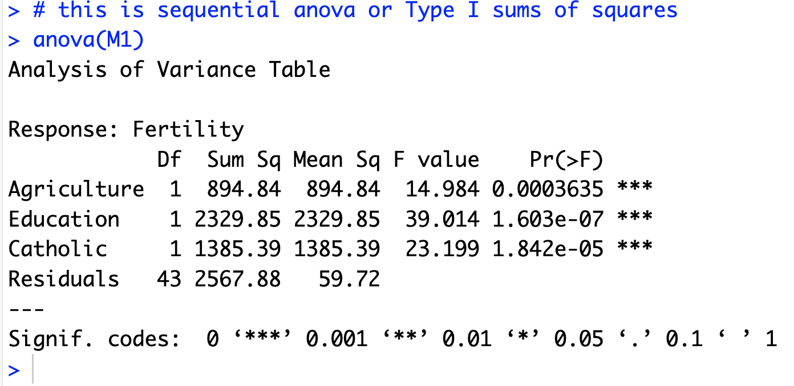
Model Mis-selection
M1 <- lm(Fertility ~ Agriculture + Education + Catholic, data = swiss)
summary()
anova()

Slide 11
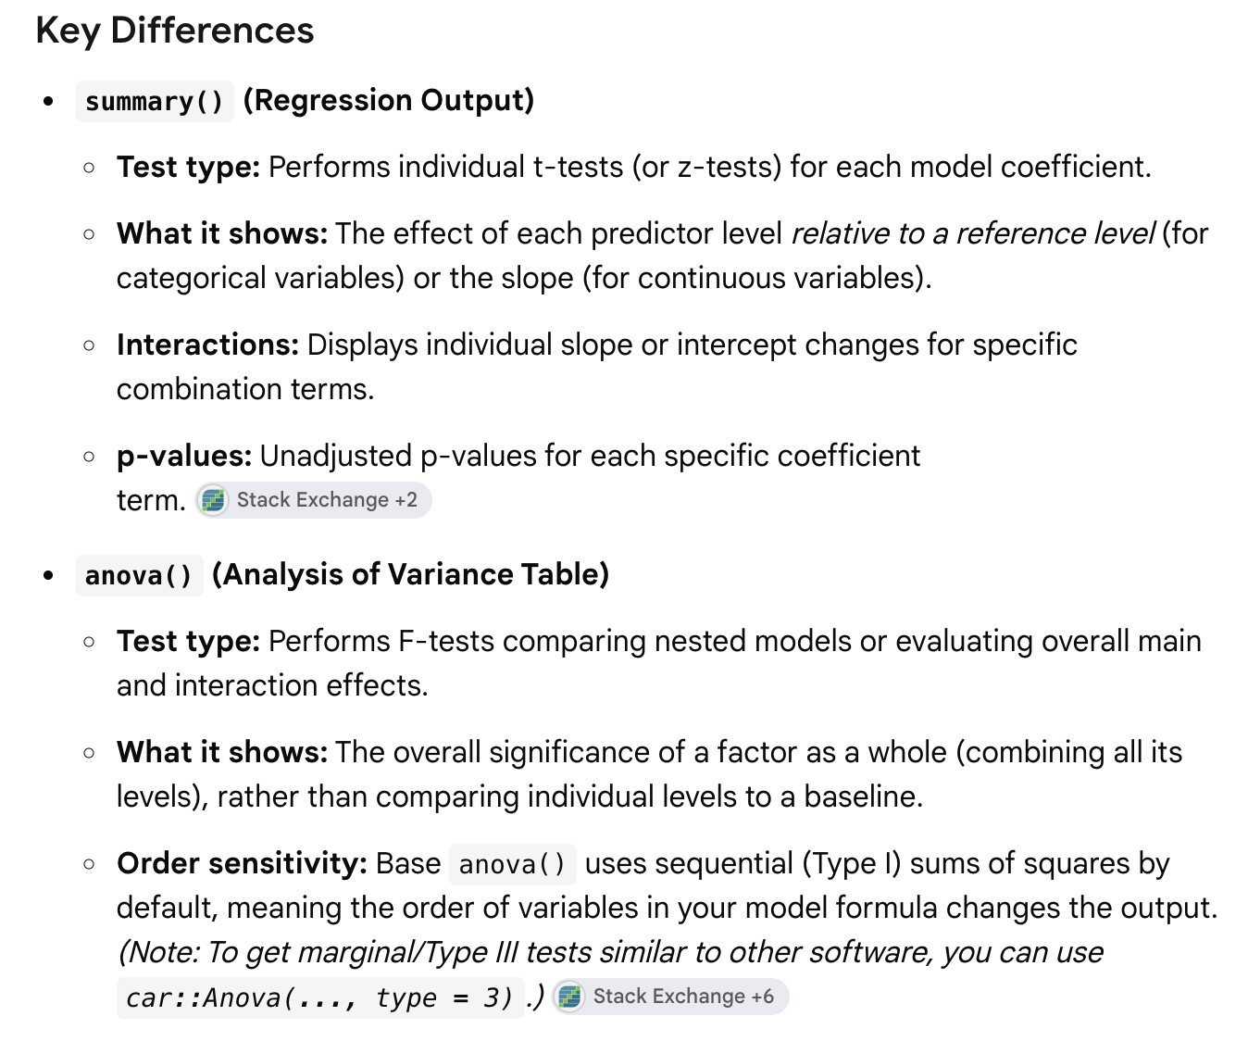
Summary () vs anova()
This is an AI summary

Slide 12
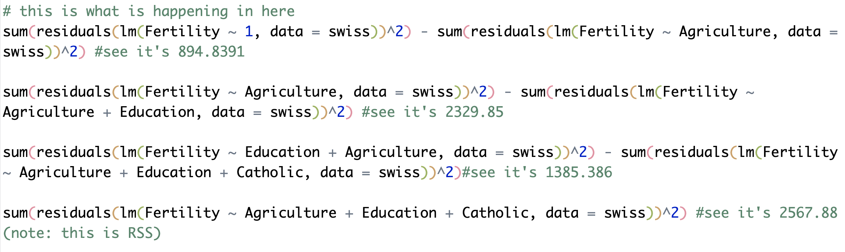
anova()
M1 <- lm(Fertility ~ Agriculture + Education + Catholic, data = swiss)

Slide 13
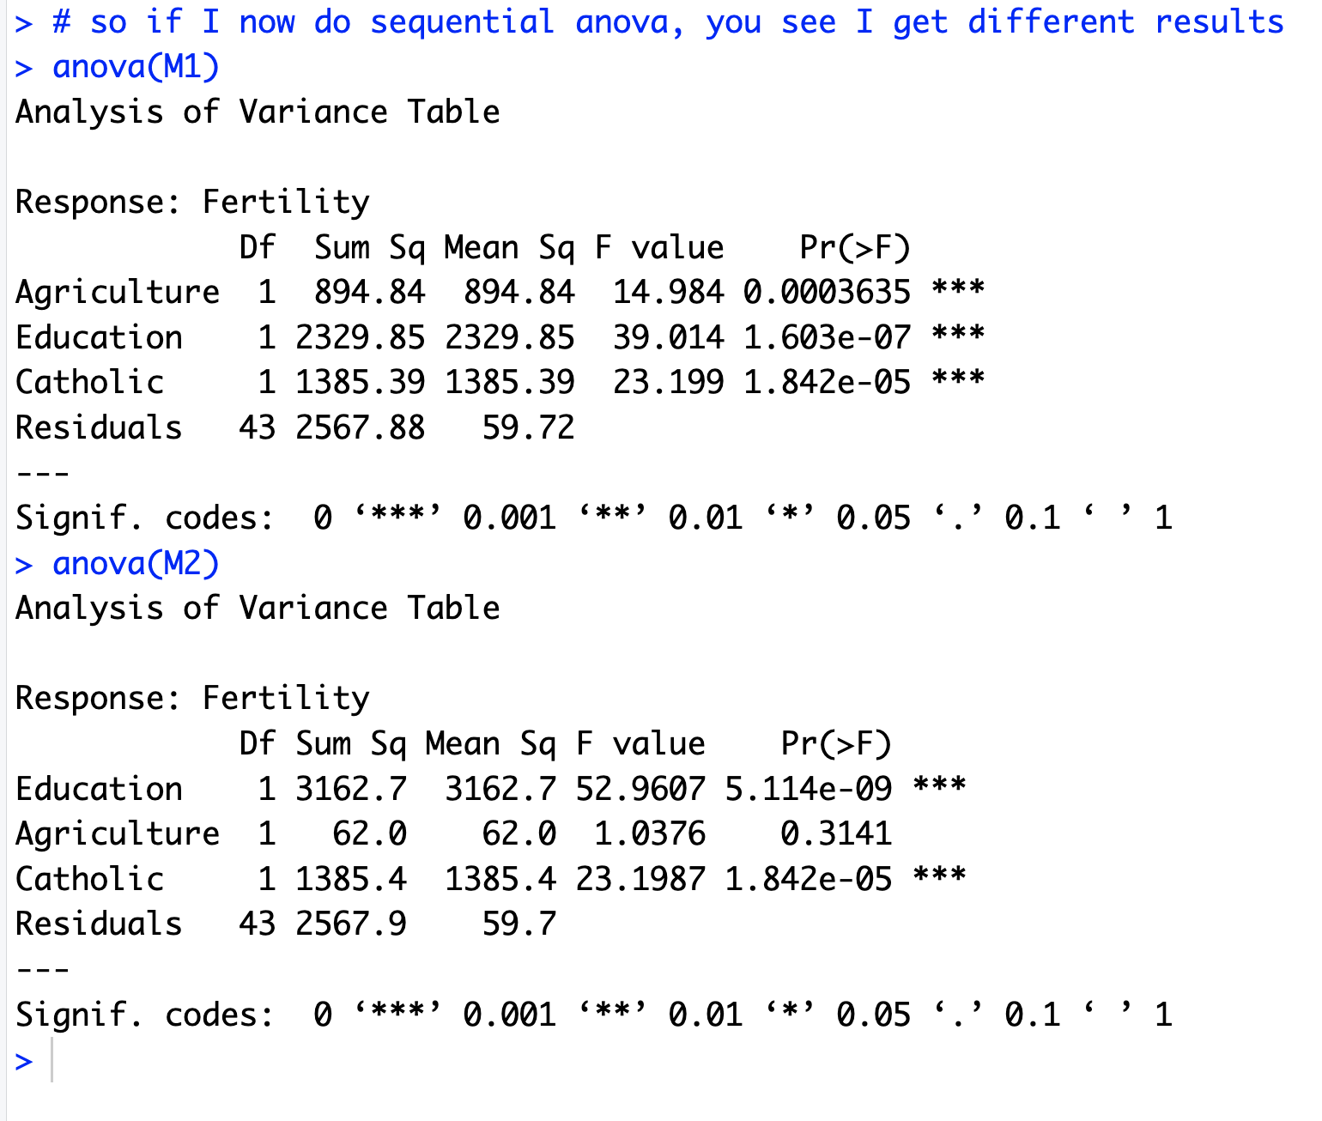
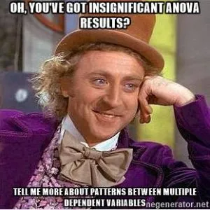
So be Careful!
M1 <- lm(Fertility ~ Agriculture + Education + Catholic, data = swiss)
M2 <- lm(Fertility ~ Education + Agriculture + Catholic, data = swiss)

Slide 14
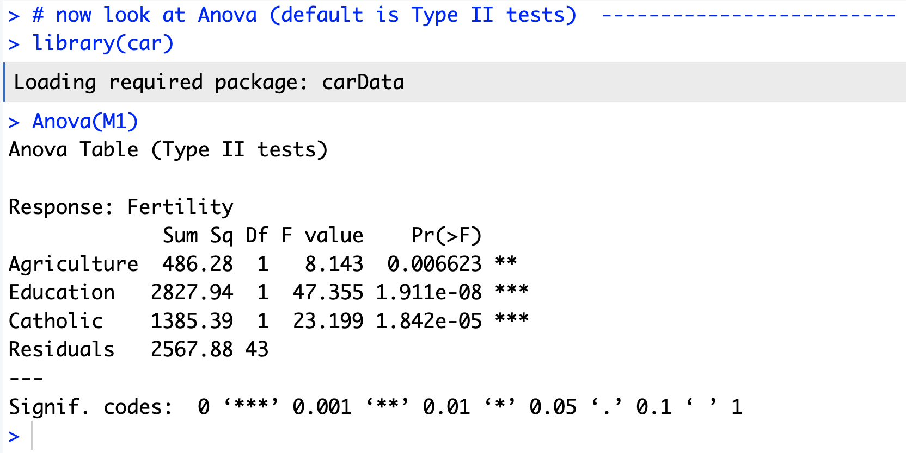
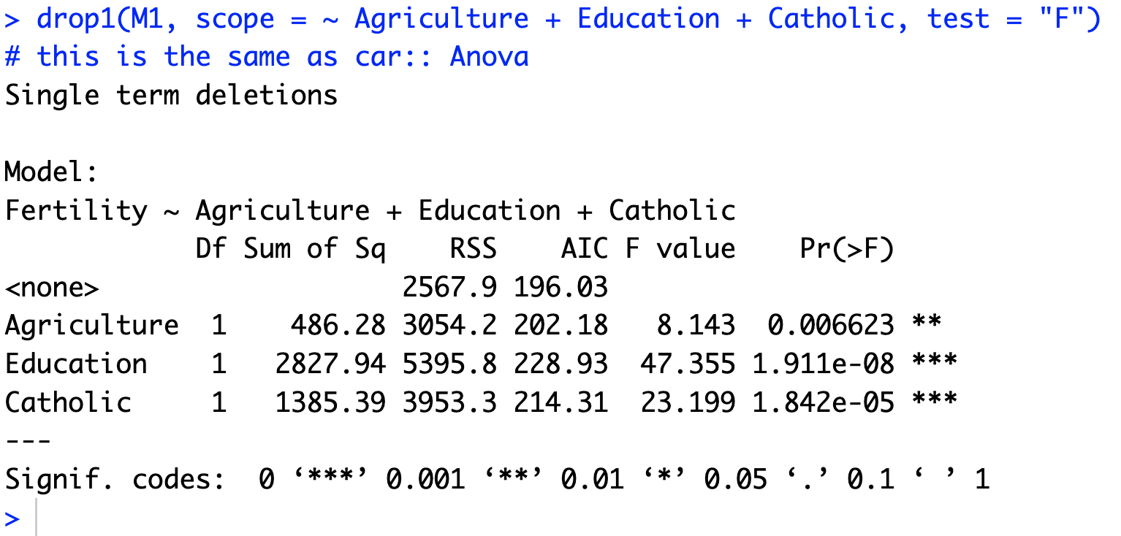
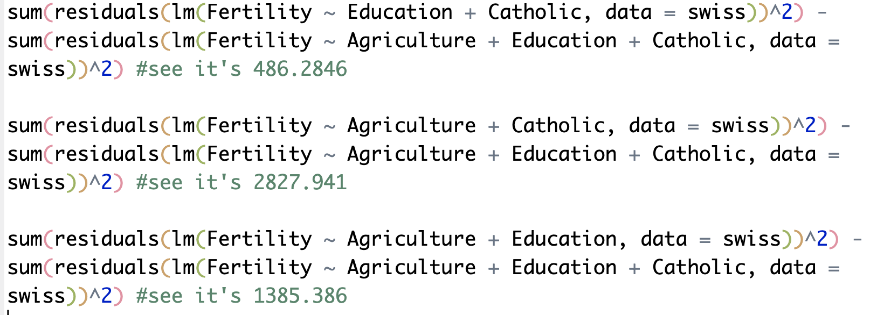
Anova() vs drop1()
M1 <- lm(Fertility ~ Agriculture + Education + Catholic, data = swiss)
drop1(M1, scope = ~ Agriculture + Education + Catholic, test = "F")
Anova()
drop1()

Slide 15

Model Criticism and Simplification
It is easy to “fall in love” with a particular model, but it is important to remember:
  All models are wrong.
  Some models are better than others.
  We can never be certain which is the correct model.
  The simpler the model, the better it is.

Slide 16
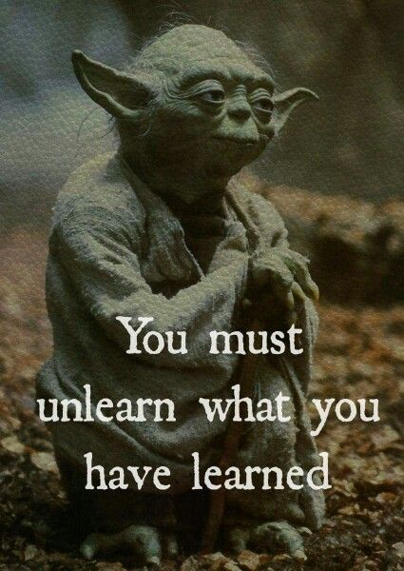
In Summary
Model comparison is not causal inference.
Stop testing, start thinking.

Slide 17

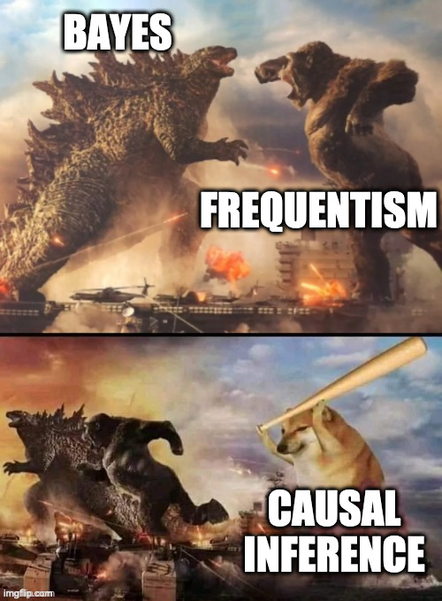

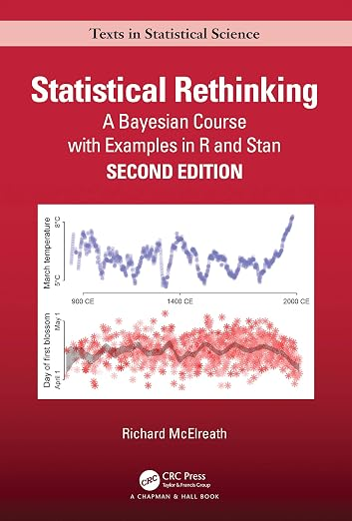
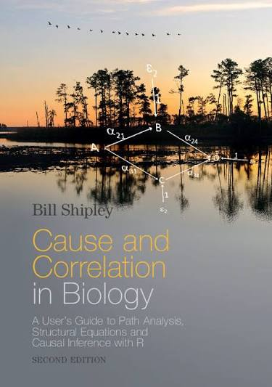


Causal Inference
Credits:
Richard McElreath
Bill Shipley
Jarrett Byrnes
Jonathan Lefcheck

Slide 18
What is Causal Inference?
Causal inference is more than learning an association (i.e., mutual information among variables).
Two concepts:
Causal inference is prediction of intervention.
Causal inference is missing data imputation.
Goals of Science
Pattern
recognition
Mechanistic
understanding
Prediction

Slide 19

Causal Imputation
Knowing a cause means being able to construct unobserved counterfactual outcomes.
What if I had done something else?

Slide 20

Today's Menu
Part 1. Causal design:
Thinking about causal model structure to build valid inference.
Part 2. Building causal models:
Directed Acyclic Graph (DAG),
D-separation, and
Structural Equation Model (SEM).
Notes:
AIC/BIC/WIC/ focus on multiple non-null models and model uncertainty, but will not fix science. There is no theory where the models come from

Slide 21
What We Want to Evaluate
Cause
Effect
Exogenous variable
Independent variable
Explanatory variable
Predictor
Endogenous variable
Dependent variable
Response variable
Notes:
Our goal is to infer causes
All inference requires casual information
What produce the sample that we are trying to describe

Slide 22
But this is the World
Cause 3
Cause
Effect
Mediator
Cause 2

Slide 23

Intervention: Experiments! What can we learn?
Cause 3
X
X
X
Cause
Effect
X
X
Mediator
X
Cause 2

Slide 24

Experiments: Manipulate Cause of Interest
Cause 3
Karl Deisseroth –
Nobel Prize winner 2026
Cause
Effect
Mediator
Cause 2
https://www.youtube.com/watch?v=bggKUbIN0Ww&t=624s
Notes:
Screen Recording 2026-10-16 at 4.22.21 PM.mp4

Slide 25
Can We Think of Multiple Regression from a Causal Standpoint?
We estimate the effect of exogenous variables controlling for all others
Covariances implied
Not controlling for the right variables = bad inference
Controlling for the wrong variables = bad inference
x₁
x₂
Y
x₃

Slide 26
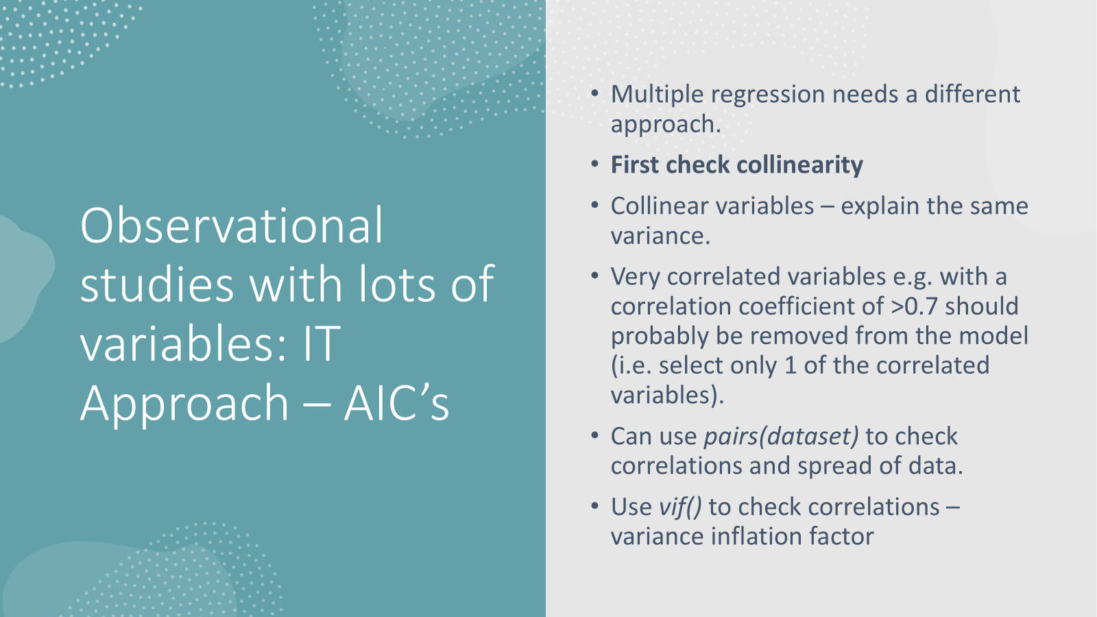
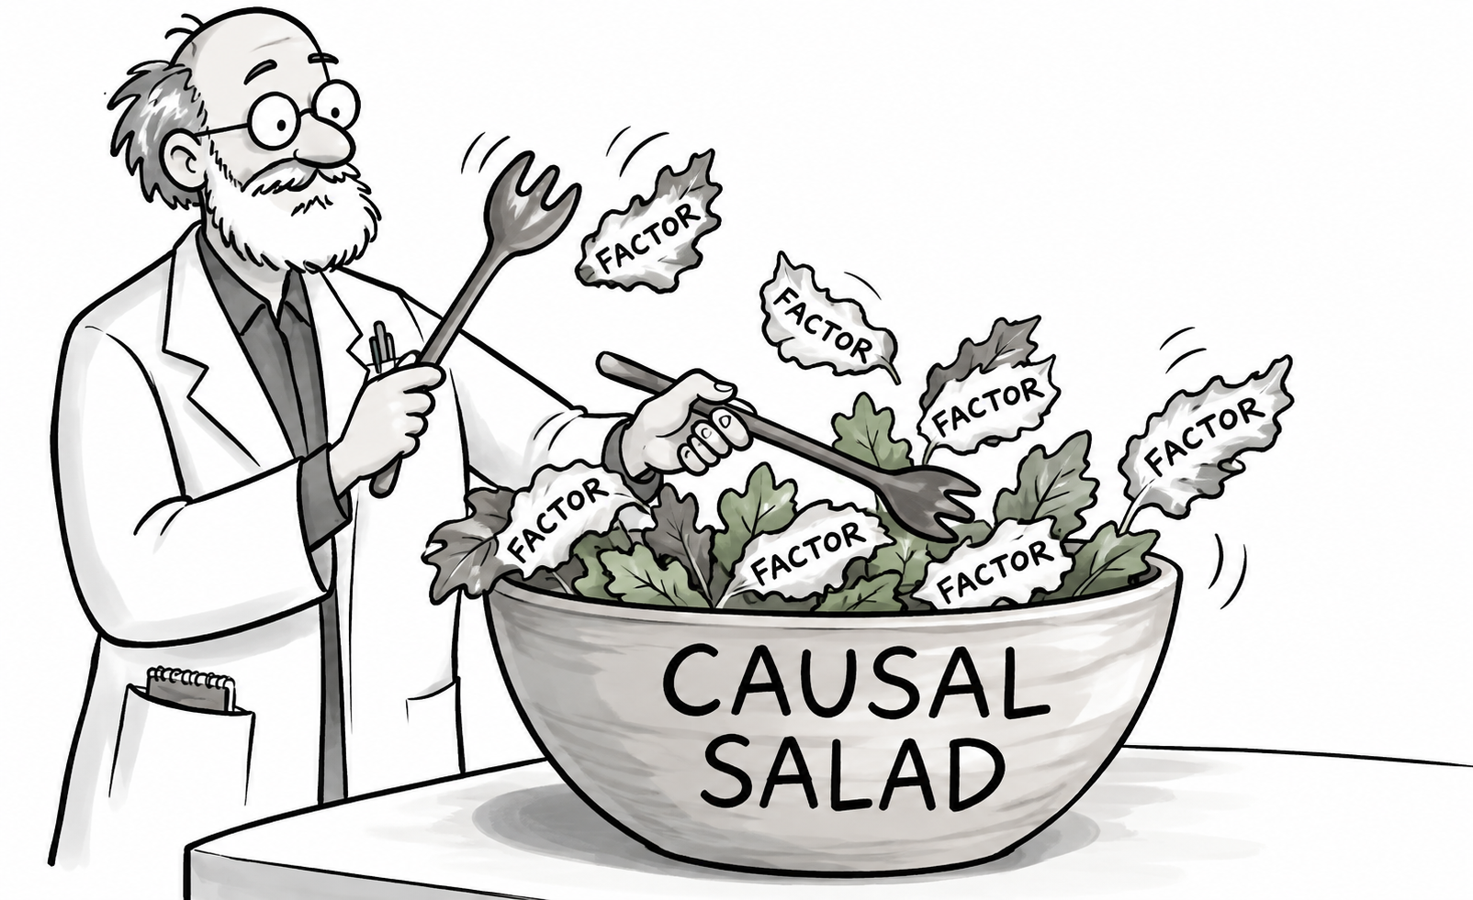
Causal Salad
Ingredients: Vague query, some relevant variables.
Add all the variables and let multiple regression sort it out.
Pretend there is no confounding.
Pretend there are is no measurement error.
Pretend pattern of missing data is of no concern.
Pretend AIC/p-values will pick the scientifically correct model.

Slide 27
Simulation example: Do students from developing countries face discrimination in PhD scholarship selection?
500 students apply for PhD scholarships in two funding schemes (E).
E: Scholarship type (i.e., highly competitive international scholarships vs targeted development scholarships).
X: Applicant's country category (i.e, developing or developed country)
Y: Scholarship outcome (i.e., awarded or rejected).
Simulation: Within each scholarship scheme, there is NO discrimination based on country category.

Slide 28
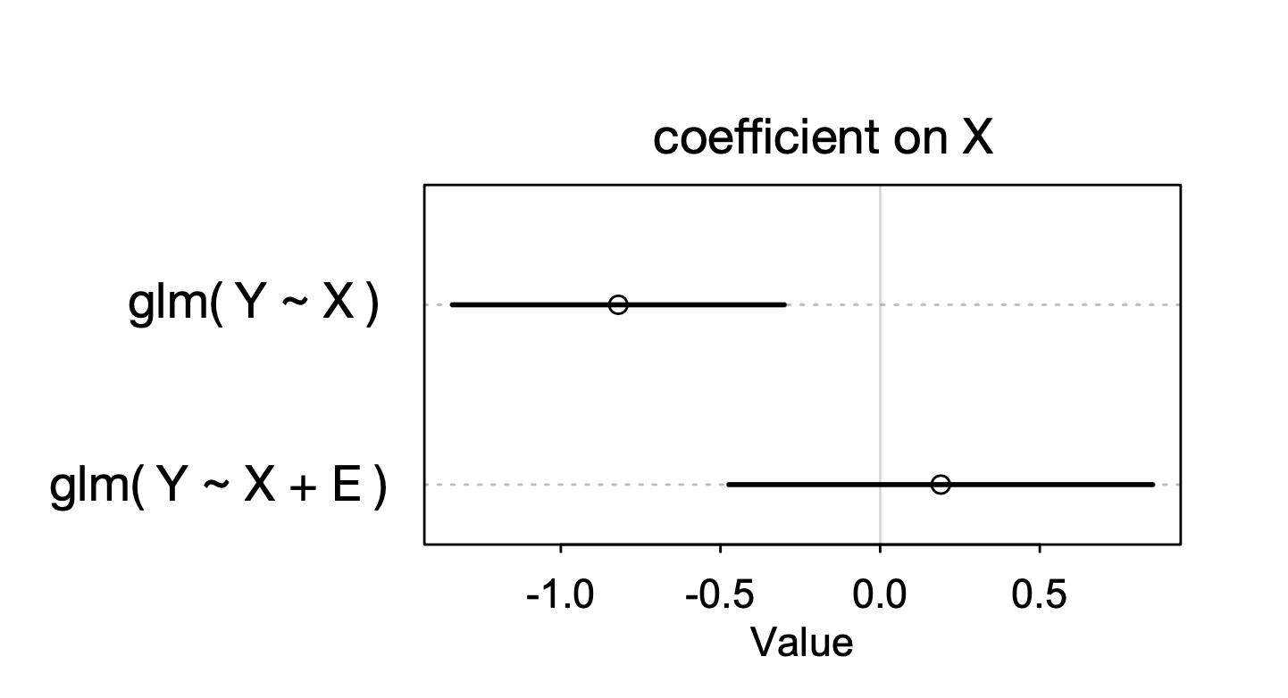
Consider two regressions (Logistic):
Y ~ X
Y ~ X + E
X: Applicant's country
E: Scholarship type
Why does E make false evidence of discrimination vanish?

Slide 29
Simulation example: Do students from developing countries face discrimination in PhD scholarship selection?
500 students apply for PhD scholarships in two funding schemes (E).
E: Scholarship type (i.e., highly competitive international scholarships vs targeted development scholarships).
X: Applicant's country category (i.e, developing or developed country)
Y: Scholarship outcome (i.e., awarded or rejected).
Simulation: Within each scholarship scheme, there IS discrimination based on country category.

Slide 30
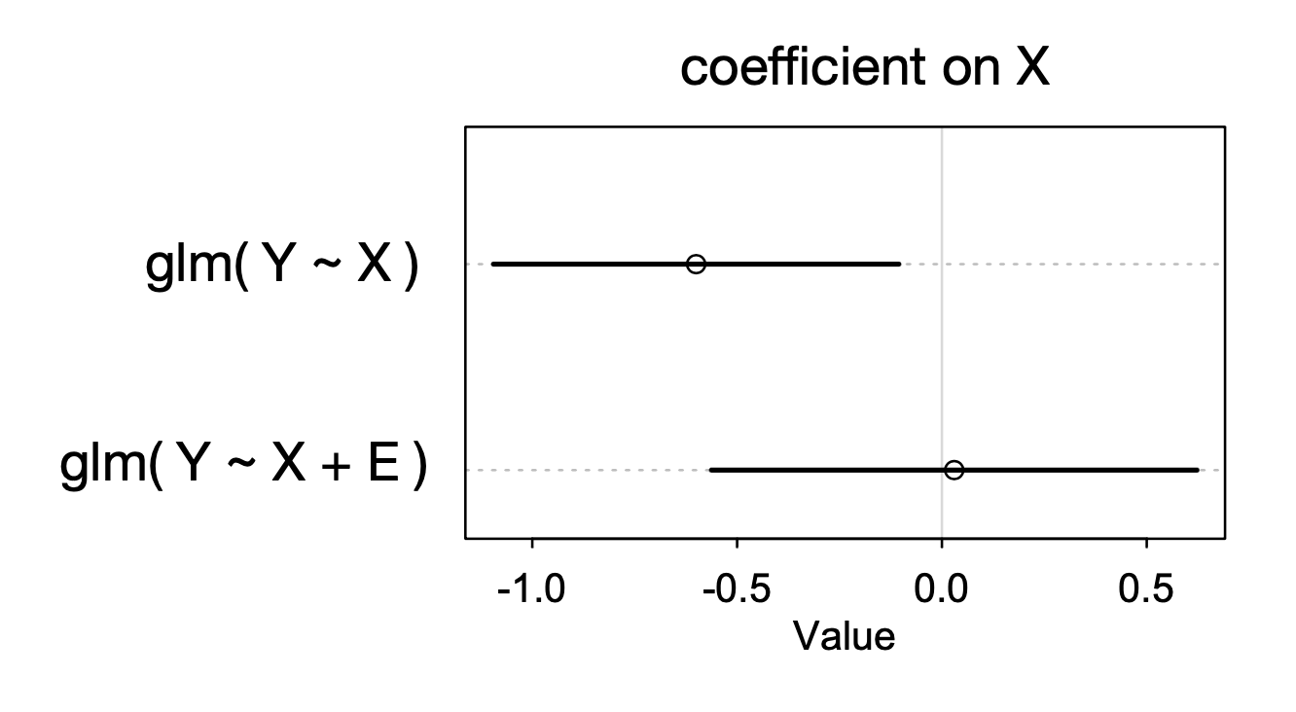
Consider two regressions (Logistic):
Y ~ X
Y ~ X + E
X: Applicant's country
E: Scholarship type
Why does E make discrimination vanish, even though there is discrimination in the simulation?

Slide 31
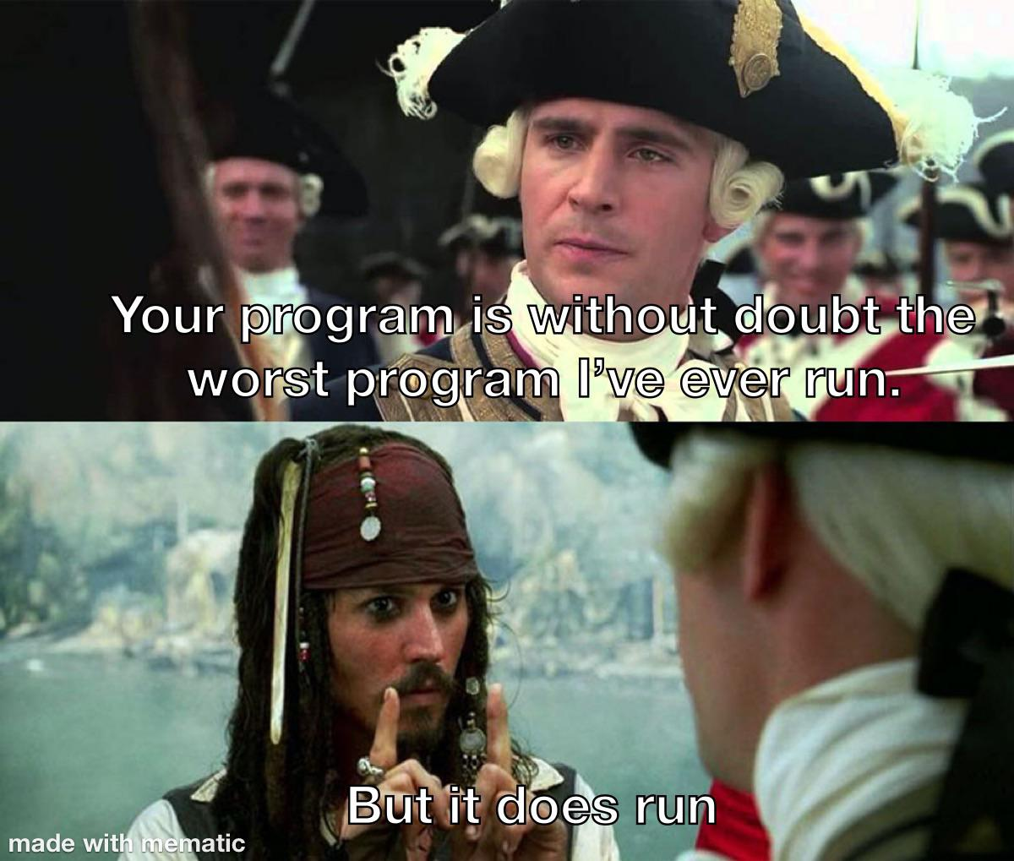
What we can learn from this ?
In real data, we do not know the truth
Change of coefficient could be revelation or deception

Slide 32
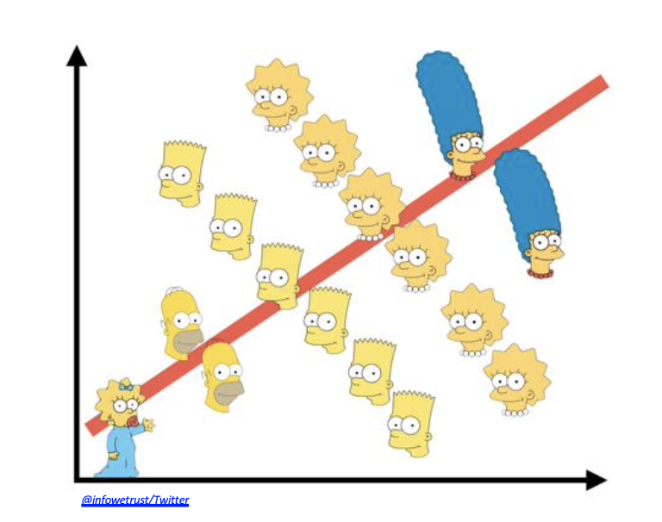
Why use multiple predictors: Simpson’s paradox
Classic Problem: Does having more native species hinder invasive species success?
Native species richness
Site
Invasive species richness
Invasive species richness
Native species richness

Slide 33
But Which Predictors? All? Some? Which?!?!?!?!
x₈
x₃
x₁
x₂
Y
x₇
x₄
x₅
x₆

Slide 34
Why not to use all predictors
1. Increased SE on all coefficients.
2. Spurious correlations might give false signals.
3. Including variables that can obfuscate the signal of causation due to causal graph structure.

Slide 35
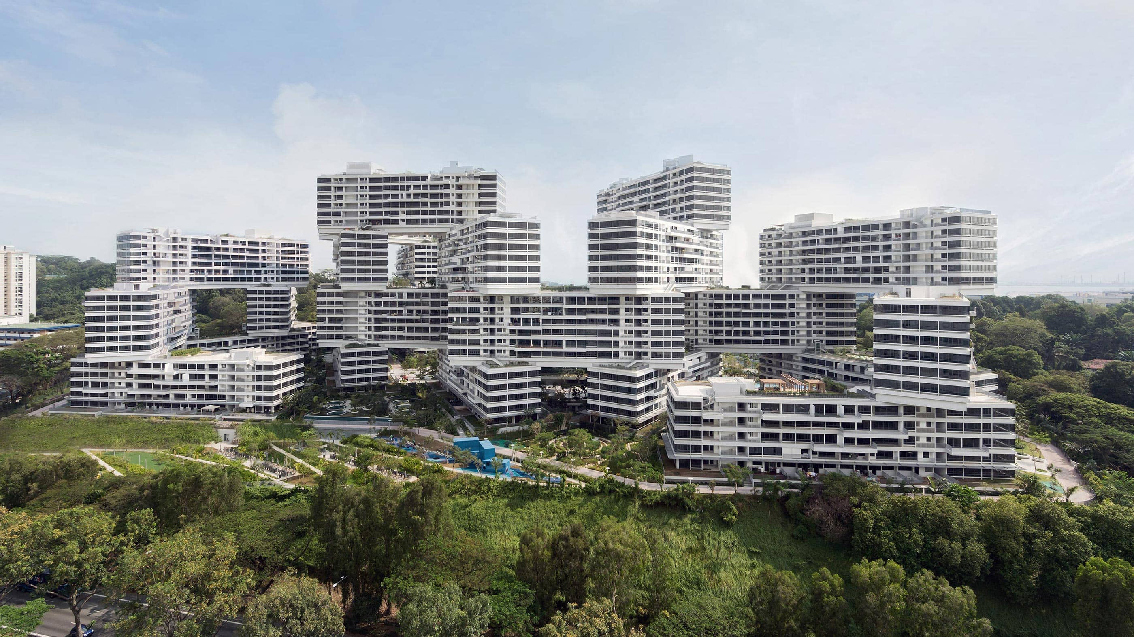
Causal Design

Slide 36
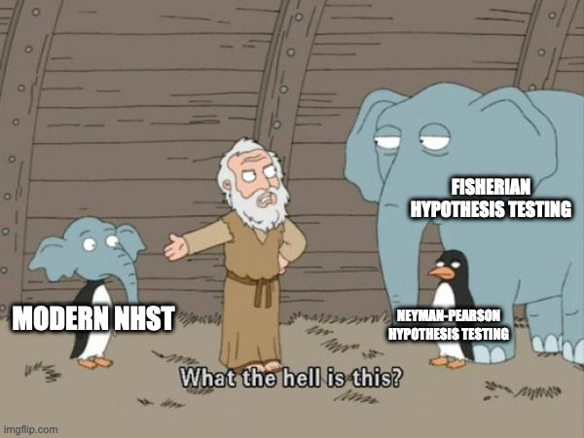
Causal Design
• Causal inference requires a model outside of the statistical model.
Step 1: Make a causal model
In simplest case, can represent these functions with arrows that connect variables (DAG: Directed Acyclic Graphs).
There is no method for making causal models other than science. There is no method to science other than honest anarchy.
Step 2: Use the model to design data collection and statistical procedures.
Modern NHST: Fisher's p-values, Neyman–Pearson's decision rules, and a lot of confusion about what statistical significance actually means.

Slide 37
Elemental paths in causal graphs (and Why to use SEM)
3. The Collider
1. The Chain/Pipe
x₁
x₂
x₁
x₂
Y
Y
4. The Fork
2. The Descendant
x₂
x₁
x₂
Y
x₁
Y
x₃

Slide 38
Chain/Pipe of foolish inference
Consider the following:
You are following a cohort of patients with tumors to see if tumor size influences buildup of blood toxins. You measure differences in tumor sizes at t0, and then again at t1, when you take blood samples.
Which tumor size(s) do you use as predictors of blood toxin concentrations? Initial, final, or both?
Truth
Initial Tumor
Final Tumor
Toxin Concentration
Causal model
Cause
Mediator
Effect

Slide 39
Consider the consequences
Truth
Initial Tumor
Final Tumor
Toxin Concentration
Regression 1
Net effect, ignoring mediator
Initial Tumor
Toxin Concentration
Regression 2
What does this mean?
Adjust effects
holding mediator
or initial constant
Initial Tumor
Toxin Concentration
Final Tumor
What does this mean?

Slide 40
1. The Chain/Pipe
Causal model
• Mediator blocks cause
Cause
Mediator
Effect
Regression 1
• Ignoring Mediator,
Cause and Effect associated
Cause
Effect
Regression 2
Cause
• Conditioned by Mediator,
Cause and Effect NOT associated
Effect
Mediator

Slide 41
Elemental paths in causal graphs (and Why to use SEM)
3. The Collider
1. The Chain/Pipe
x₁
x₂
x₁
x₂
Y
Y
4. The Fork
2. The Descendant
x₂
x₁
x₂
Y
x₁
Y
x₃

Slide 42
Will a child set us free?
Consider the following:
What if we knew the final tumor was shedding cells, and we had their concentration. Should we control for that?
Truth
Initial Tumor
Final Tumor
Toxin Concentration
Shed Cells

Slide 43
2. The Descendant Problem
Causal Model
Cause
Mediator
Effect
Descendent
Regression
Descendant still partially blocks cause
Masks effect of cause – many possibilities
Cause
Effect
Descendent

Slide 44
Elemental paths in causal graphs (and Why to use SEM)
3. The Collider
1. The Chain/Pipe
x₁
x₂
x₁
x₂
Y
Y
4. The Fork
2. The Descendant
x₂
x₁
x₂
Y
x₁
Y
x₃

Slide 45
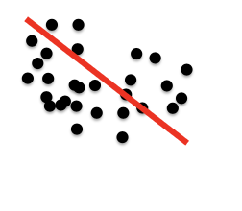
A Collision of Sampling and Regression
Consider the following:
You are interested to see if academic ability and athletic ability are correlated. So, you sample students at your collage.
Athletic ability
Academic ability

Slide 46
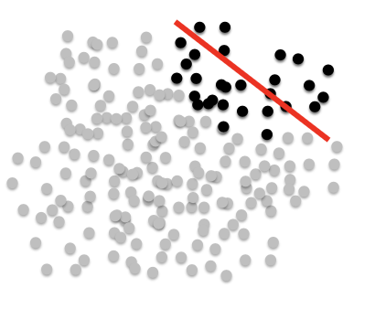
A Collision of Sampling and Regression
But how do you get into college?
Academic Ability
College Admit
Athletic Ability
Athletic Ability
Academic Ability

Slide 47
3. The Collider
Causal Model
Cause 1
Effect
Cause 2
Regression
Ignoring Effect, Cause 1 and Cause 2 NOT associated
Conditioned by Effect, Cause 1 and Cause 2 associated
Creates spurious correlations
Cause 1
Cause 2
Effect

Slide 48
Collider Bias
Preliminary studies suggested that
Healthcare workers were likely to get less severe Covid infections
b) Covid infection was lower among smokers
WHY?
COVID-19 severity
Smoking
Healthcare worker
COVID-19 testing
Griffith et al. 2020,
https://doi.org/10.1038/s41467-020-19478-2

Slide 49
Elemental paths in causal graphs (and Why to use SEM)
3. The Collider
1. The Chain/Pipe
x₁
x₂
x₁
x₂
Y
Y
4. The Fork
2. The Descendant
x₂
x₁
x₂
Y
x₁
Y
x₃

Slide 50
4. The Fork
Causal Model
Exogenous Cause
Cause
Effect
Regression 1
Regression 2
Cause
Effect
Cause
Effect
Ignoring Exogenous Cause, Cause and Effect associated
The relationship is contaminated – results unreliable!
Exogenous Cause
Conditioned by Exogenous Cause, Cause and Effect NOT associated
Nothing – this is great!

Slide 51
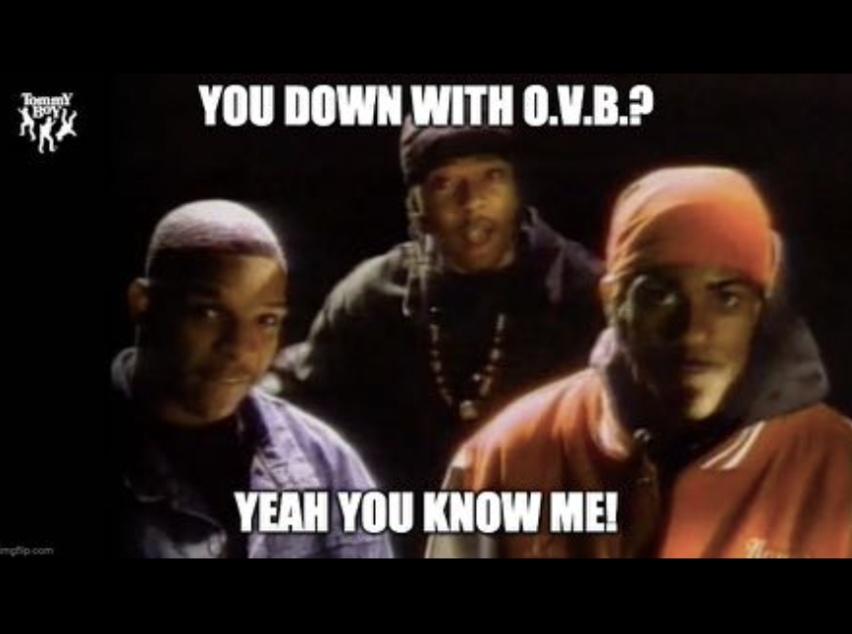
The Bigger Problem: The Omitted Variable Bias Problem
Causal Model
Exogenous Cause
Cause
Effect
We assume that sampling means that omitted variables average to 0 – Omission produces downward bias in SE of coefficients.
But, if omitted variables are correlated causally with a predictor, they likely are not averaged out.
This will bias your estimates – You will not know in what direction.

Slide 52
Elemental paths in causal graphs (and Why to use SEM)
3. The Collider
1. The Chain/Pipe
x₁
x₂
x₁
x₂
Y
Y
4. The Fork
2. The Descendant
x₂
x₁
x₂
Y
x₁
Y
x₃

Slide 53
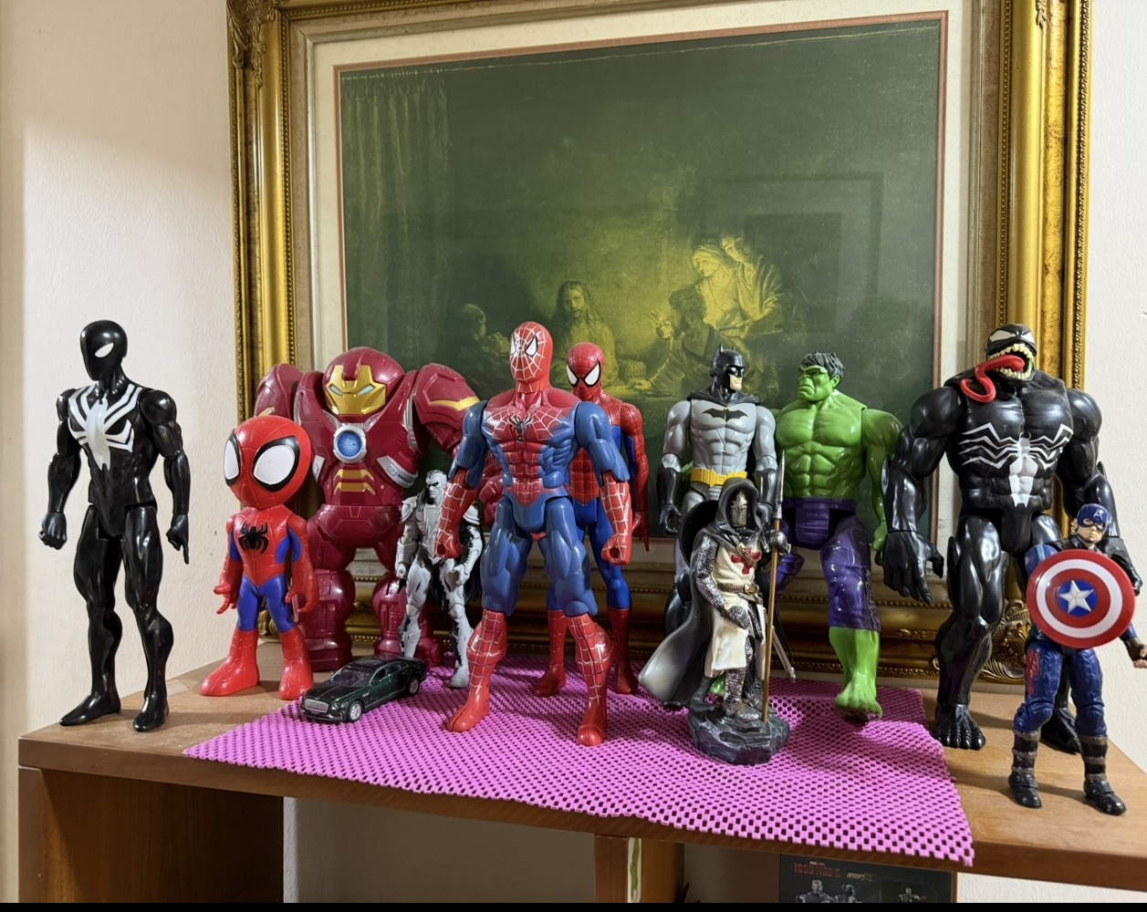
You are now Armed and Dangerous

Slide 54

Translating between the languages of Causation and Probability Theory
How to replace the notion of physically controlling a variable in a causal system with the notion of a statistical control in a causal system.
Language of science
Concepts of cause - effect, direct and indirect causes, causal independence, etc.
Language of graph theory
Concepts of direct acyclic graphs (DAGs), paths, ancestors, dependents, etc.
Languages of probability theory
Concepts dependence, independence, conditional distributions, marginal distribution.....
D-separation
Judea Pearl
Causality: Models, Reasoning, and Inference (2000)
The Book of Why: The New Science of Cause and Effect (2018)

Slide 55
Expressing Causal Hypotheses using DAGs (Directed Acyclic Graphs)
Variables A, e_{b} and e_{c} are casually independent of each other.
A and e_{b} each directly cause changes in variable B.
Variables B and e_{c} are also causally independent of each other and each directly causes changes in variable C.
A
B
C
Important: the mathematical statement, X→Y in a DAG DOES NOT mean X is correlated with Y. It means that “A change in X will provoke a change in Y even when all other variables in the DAG are prevented from changing but a change in Y will not provoke a change in X”
e_{b}
e_{c}
The same causal hypothesis expresses as a DAG

Slide 56
D-separation is a mathematical operation on a DAG
X
U
V
W
Y
S₁
S₂
X
U
S₁
Directed path
Non-collider (U)
X
U
V
(Undirected) path
Collider (U)
Natural state of a variable along a path:
Collider: blocks the flow of statistical information through it.
Non-collider: allows the flow of statistical information through it.
Notes:
When we say “statistical information passes from X to Y” in causal inference, we mean that knowing the value of X tells us something about the likely value of Y.

Slide 57
Let’s do a Test
X
U
V
W
Y
S₁
S₂
Is there a directed path from V to S₂ ?
Is there an undirected path from V to S₂ ?
Is W a collider or non-collider along the undirected path between V to S2
Is there a directed path from U to Y ?
Is W a collider or a non-collider along the undirected path between U to Y ?
Notes:
Yes, Yes, Non-collider, No, Yes

Slide 58
D-separation is a Mathematical Operation on a DAG
Natural state of a variable along a path:
Collider: blocks the flow of statistical information through it.
Non-collider: allows the flow of statistical information through it.
Conditioning on a non-colder reverses its natural stat and blocks the flow of statistical information through it.
Conditioning on a collider or on the descendent of a collider reverses its natural state and allows the flow of statistical information through it.

Slide 59
An example of a d-Separation claim
X
U
V
W
Y
S₁
S₂
Is X d-separated from W given U ?
X || W {U} ?
Step 1: Write down all (undirected) paths between X and W
X
U
V
W
{U}
Step 2: Now check the conditional set
Concussion: X is not d-separated from W, given (conditional on) U
Notes:
No

Slide 60
An example of a d-Separation claim
X
U
V
W
Y
S₁
S₂
Is U d-separated from S₂ given V ?
U || S₂ {V} ?
Y || U {S2} ?
V!
_________
2 ^{V- 2}
(V -2)! 2!
X || W {S1, V} ?
Basis set
You only need to test those in the basis test
Notes:
Yes, No, Yes
Axiom of conditional independence

Slide 61
Practicing to master the notion of d-Separation
X
U
V
W
Y
S₁
S₂
library(ggm)
my.dag<-DAG(U~ X + V, S1 ~ U, W ~ V + Y, S2 ~W)
# evaluating a d-separation claim
# U_||_S2|{X,W}
dSep(amat=mydag_first="U",second="S2",cond=c("X","W"))
Open Script_2 and run codes under “### exercise 1”

Slide 62
What have we discussed so far?
1. Statistical model selection
Akaike Information Criterion (AIC)
Stepwise regression (forward, backward, and bidirectional selection)
Model averaging
2. Model evaluation and comparison
summary()
anova()
Anova()
drop1()
3. Causal inference and model building
Directed acyclic graphs (DAGs)
Common causal structures: chains (pipes), Descendants, Forks, and Colliders
d-separation

Slide 64
How can we build a multiple regression model to estimate the causal effect of X₁ on Y?
Ask: Which need to be closed to estimate effect of X₁ on Y?
X₂
X₁
Y
X₃

Slide 65
How can we build a multiple regression model to estimate the causal effect of X₁ on Y?
Ask: Which need to be closed to estimate effect of X₁ on Y?
X₃
X₂
X₄
X₁
Y

Slide 66
How can we build a multiple regression model to estimate the causal effect of X₁ on Y?
Ask: Which need to be closed to estimate effect of X₁ on Y?
X₃
X₂
X₄
X₁
Y
X₅

Slide 67
Why is the d-Sep test performed on a DAG?
The d-sep test is designed to tell us whether we should retain the proposed DAG or not. If the DAG is rejected, we stop there and conclude that the data were not generated according to our hypothesised causal model.

Slide 68
The d-sep test of A DAG
The null hypothesis:
(i). The observed data were generated by the hypothesized DAG.
(ii). Each of the predicted d-separation claims in the DAG are true.
If the null hypothesis is true, the the C statistic will not be unusually large and the null probability will not be unusually small
If the null probability is larger than your chosen significance level (alpha = 0.05) then we DO NOT reject the null hypothesis (and your DAG).
E.g.,
Root Mean Square Error of Approximation (RMSEA)
Comparative Fit Index (CFI)
Standardized Root Mean Square Residual (SRMR)

Slide 69
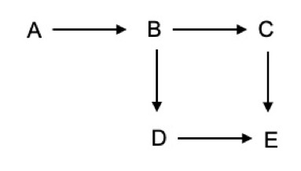
Scenario:
Conservation scientists suggest that bee abundance in Singapore has declined due to urbanisation. As a solution, they propose that increasing the number of urban parks with greenery could help enhance bee populations.
Research Question:
Can bee abundance be increased by adding more urban parks to Singapore’s landscape?
Causal hypotheses:
An increase in the number of urban parks (A) enhances plant cover (B) within Singapore’s urban landscape.
Greater plant cover (B) positively influences both floral richness (C) and floral abundance (D).
In turn, higher floral richness (C) and floral abundance (D) contribute to increased bee abundance (E).
Open Script_2 and run codes under “### exercise 2”

Slide 70
Structural Equation Modeling
Structural
There is hypothesized
underlying
structure to
nature (a cause and an effect)…
Equation
…that can be
translated to
a series of
mathematical
equations…
Modeling
…which can be modelled against data to support or refute the proposed
structure
S
E
M

Slide 71
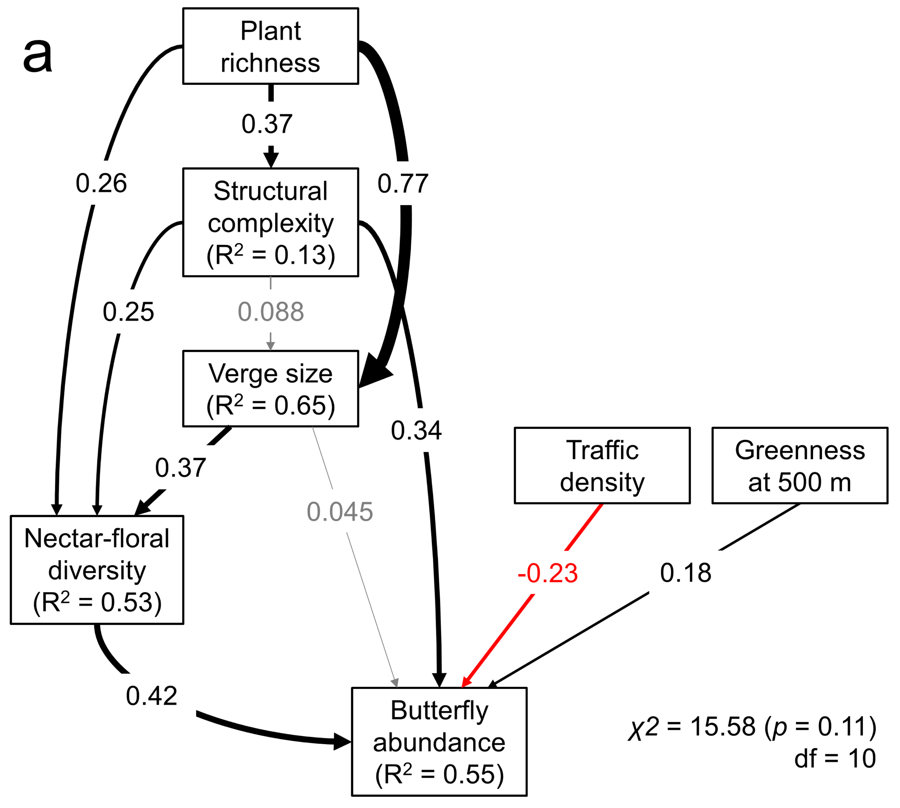
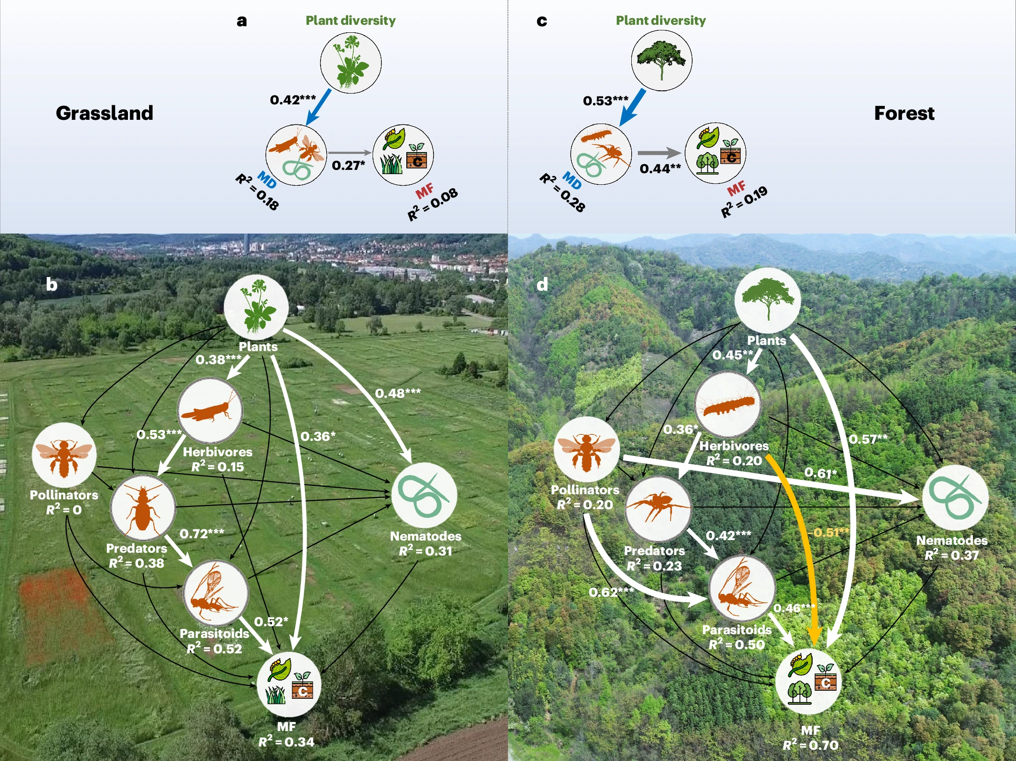
What is Structural Equation Modelling?
Can be thought of as a series of equations united in a single causal network.
Can investigate the flow of effects through a system (i.e., simultaneously estimating both direct and indirect effects of variables on each other).
Can be used to test an a priori hypothesized path model or to develop an exploratory model.
Priyadarshana et al., 2025,
10.1016/j.landurbplan.2025.105335
Li et al., 2024,
https://doi.org/10.1038/s41559-024-02517-2

Slide 72
SEM analysis steps
1. Build a hypothesized causal structure (based on theory and/or expert knowledge)
2. Collect data and fit the model
3. Test data against the proposed causal structure (i.e., test the goodness-of-fit/evaluate the model/model fit) and extract inferences
4. Modify the model if necessary and if carrying an exploratory analysis

Slide 73
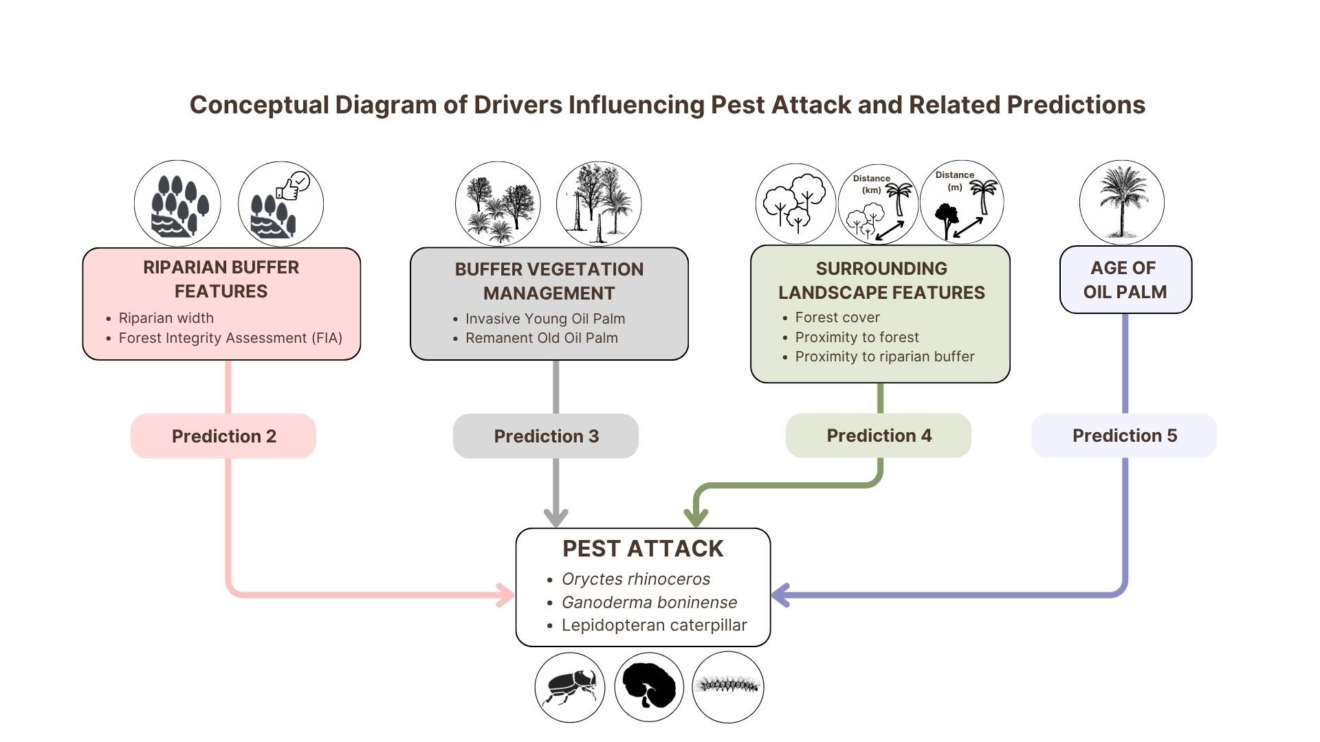

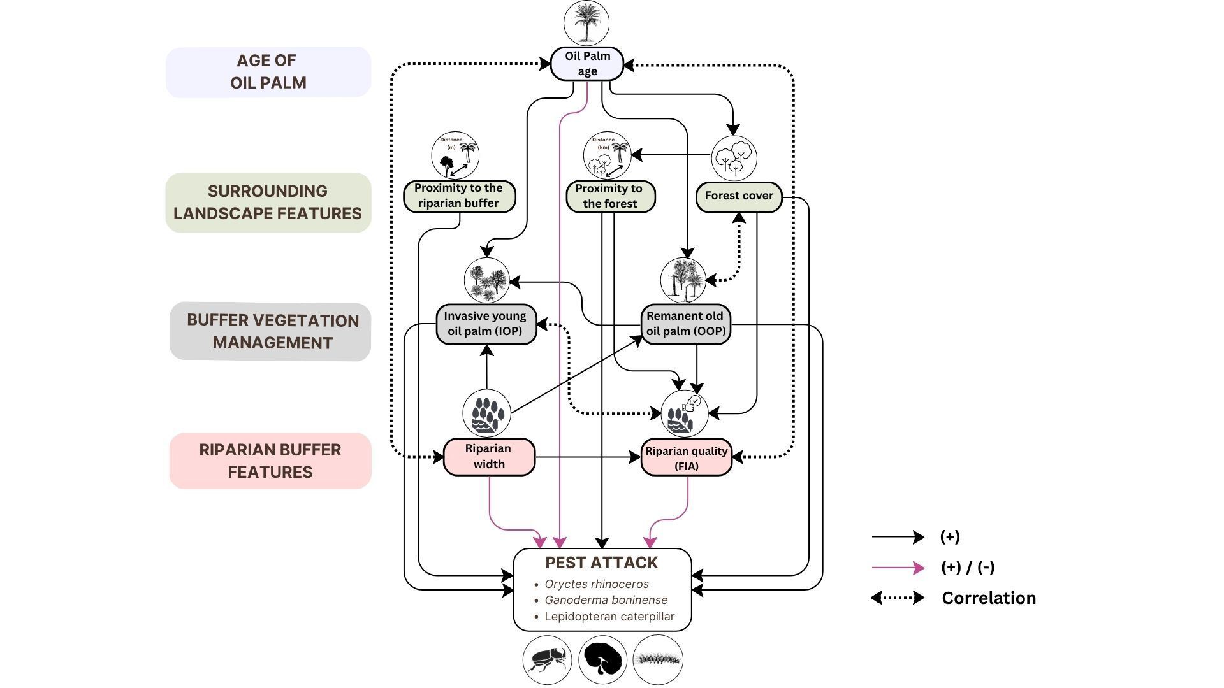

Chiew et al., 2026
In review, J. Appl. Ecol.
Preprint: https://doi.org/10.64898/2026.02.10.704761

Slide 74
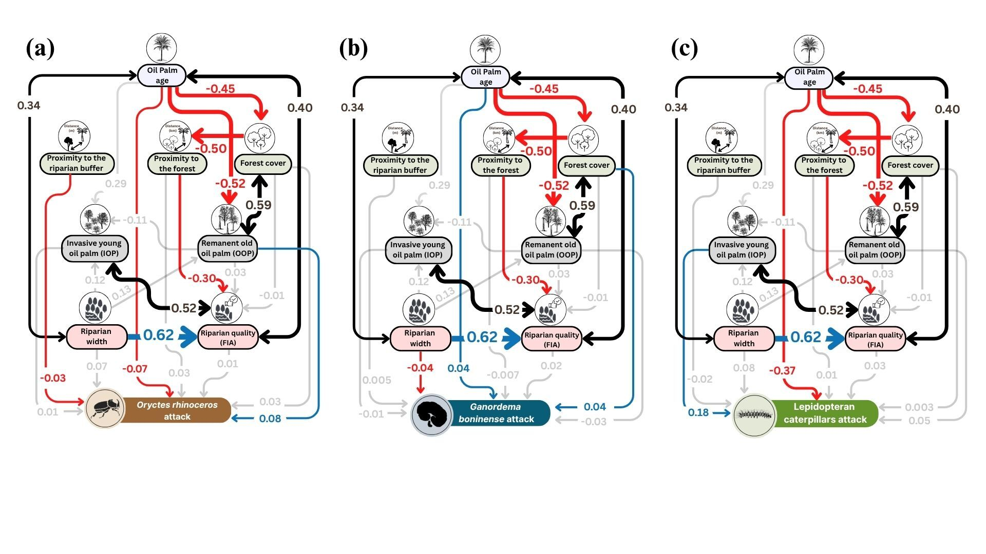
Results
Chiew et al., 2026
In review, J. Appl. Ecol.
Preprint: https://doi.org/10.64898/2026.02.10.704761

Slide 75
Global and Local estimation SEMs
Local estimation SEM
Breaks the model in sub-models
Evaluates the importance of missing paths for the model
Allows generalized mixed models
piecewiseSEM R-package
Global estimation SEM
Considers the model as a whole
Compares observed covariances to model covariances
A linear modeling technique
lavaan R-package

Slide 76
Advantages and Limitations of SEM
Study the direct and indirect effects of explanatory variables.
It does not assume that only the dependent variable is subject to measurement error.
Evaluates the whole model.
Can be used to test latent variables (cannot be observed or measured).
Large sample size.
The method is continuously developed.

Slide 77
Let’s go through a real example
The indirect effects of habitat disturbance on the bird communities in a tropical African forest
Mammides et al., 2015
Biodiversity Conservation
https://doi.org/10.1007/s10531-015-1001-x

Slide 78
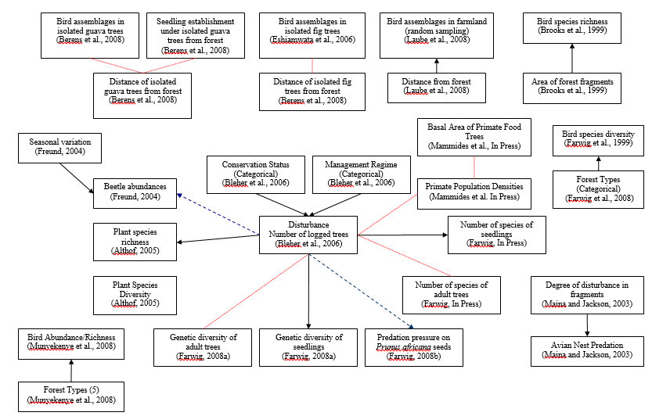
Reviewed the literature

Slide 79
Proposed casual model/DAG
Human pop. density
Canopy openness
FHD = Foliage Height Diversity
FHD
Habitat disturbance
Bird communities
Plant diversity
Distance to forest edge
Open Script_3 and run codes for this analysis

Slide 80
Results
Canopy openness
R²=0.39
0.011
0.62
FHD
R²=0.45
-0.67
0.26
Habitat disturbance
R²=0.008
-0.10
Bird richness
R²=0.56
-0.45
Plant diversity
R²=0.20
0.46
-0.10
X² = 2.76 (p = 0.89)
df = 6
Distance to forest edge
0.31
HD CO BR = 0.62 x 0.011 = 0.00682
HD FHD BR = -0.67 x 0.26 = -0.1742
HD PD BR = -0.45 x 0.46 = -0.207
0.00682 +(-0.1742)+(-0.207) = -0.37
Bird Assemblages | Indirect effects | Direct effects | Total effects
Overall Richness | -0.37 | -0.1 | -0.47

Slide 81
Think Critically!
SEM is a tool, it is up to the user to employ it thoughtfully.
Do not rely on the statistics as much as what you know about biology and ecology.
If the answer does not make sense, assume the model or test is wrong!
My Advice!
Start by drawing a causal diagram (DAG) that reflects your research question(s).
Build your DAG based on evidence from previous studies, your understanding of the study system and underlying ecological mechanisms, and expert knowledge.
“No causes in, no causes out!” — Nancy Cartwright
Remember!
Your DAG should represent your causal assumptions, not simply the statistical relationships observed in your data.
Priyadarshana & Slade 2026,
https://doi.org/10.1016/j.cois.2026.101538

